Slide 1



Work on all the aggregation and its operators

Slide 2
Security

Slide 3
Security Introduction
Maintaining a secure MongoDB deployment requires administrators to implement controls to ensure that users and applications have access to only the data that they require.
MongoDB provides features that allow administrators to implement these controls and restrictions for any MongoDB deployment.

Slide 4
Authentication
Before gaining access to a system all clients should identify themselves to MongoDB.
This ensures that no client can access the data stored in MongoDB without being explicitly allowed.

Slide 5
Authentication Mechanisms
SCRAM-SHA-1 verifies supplied user credentials against the user’s name, password and database. The user’s database is the database where the user was created, and the user’s database and the user’s name together serves to identify the user.

Slide 6
Authenticate When First Connecting to MongoDB
1. Specify your credentials when starting the mongo instance:-
When using mongo to connect to a mongod or mongos, enter your username, password, and authenticationDatabase. For example:
>mongo --username "prodManager" --password "cleartextPassword" --authenticationDatabase "products"

Slide 7
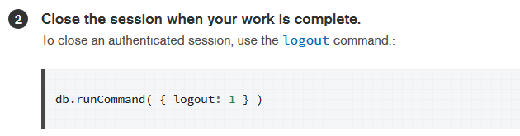
Authenticate When First Connecting to MongoDB

Slide 8
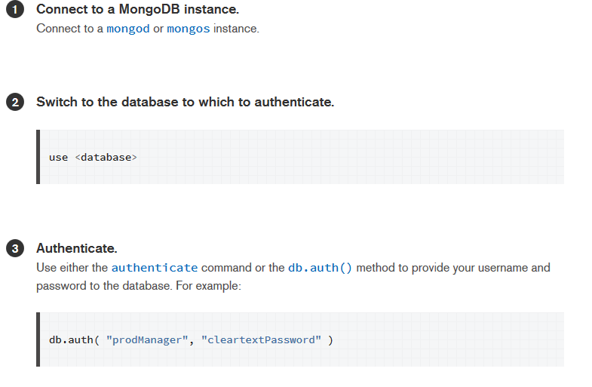
Authenticate After Connecting to MongoDB

Slide 9
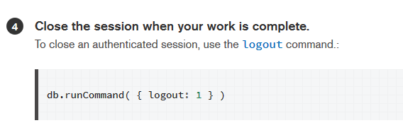
Authenticate After Connecting to MongoDB

Slide 10
Authorization
MongoDB employs Role-Based Access Control (RBAC) to govern access to a MongoDB system.
A user is granted one or more roles that determine the user’s access to database resources and operations. Outside of role assignments, the user has no access to the system.

Slide 11
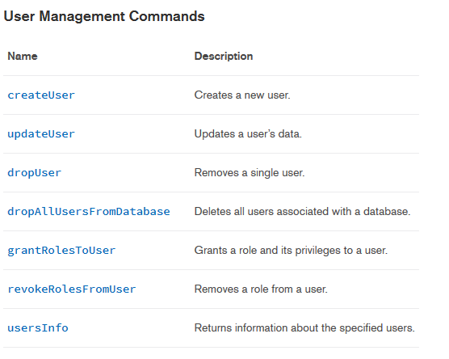
User Management Commands

Slide 12
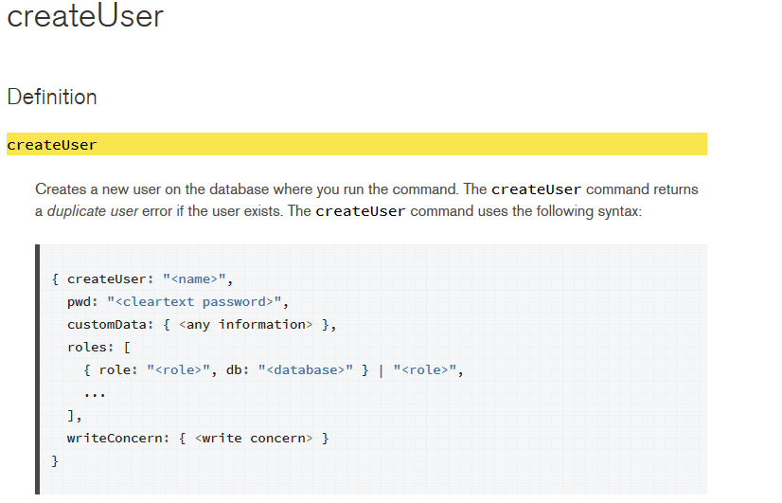
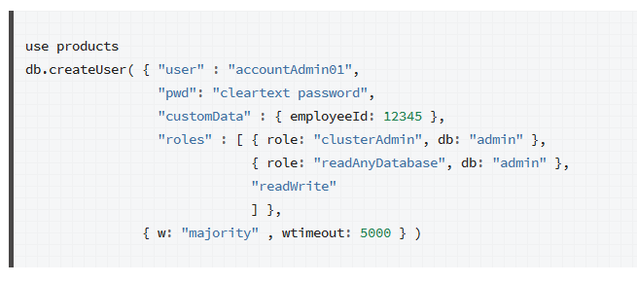
User Management Commands

Slide 13
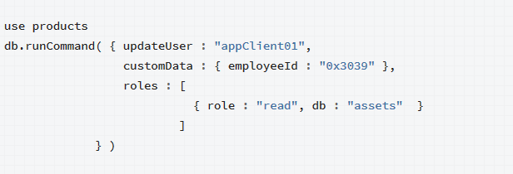
User Management Commands
UpdateUser:-

Slide 14
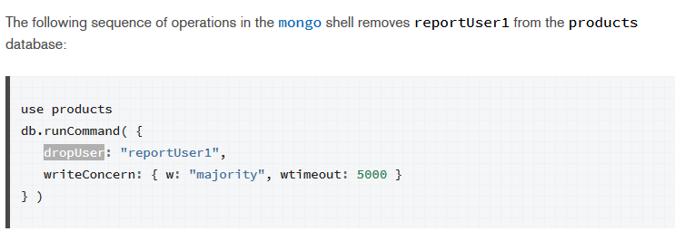
User Management Commands
dropUser:-

Slide 15
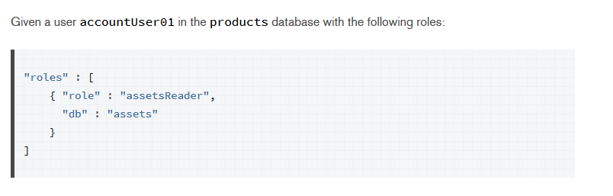
User Management Commands
grantRolesToUser:-

Slide 16
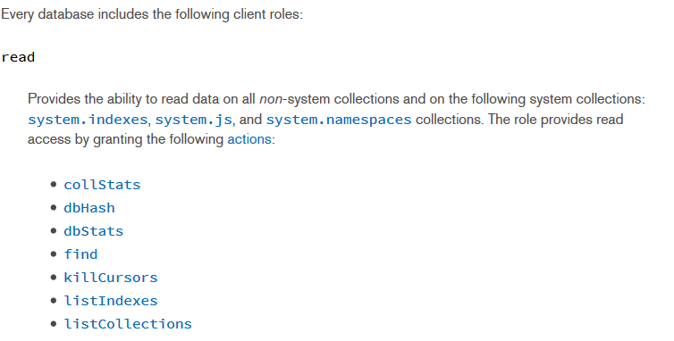
User Management Commands
Database User Roles:-

Slide 17
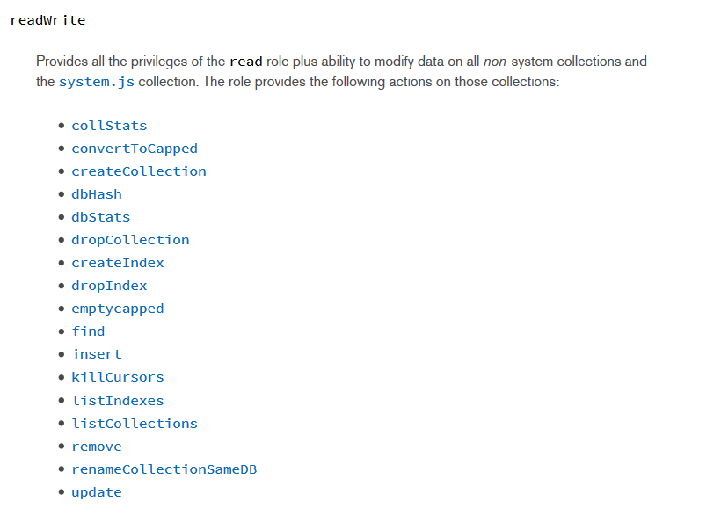
User Management Commands

Slide 18
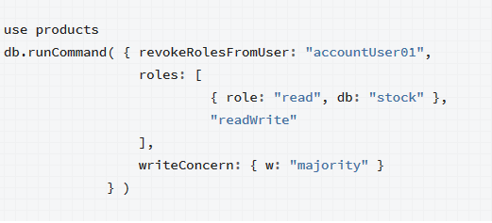
User Management Commands
revokeRolesFromUser:-

Slide 19

How to find all the user in database ?
What is “auth” in config file ?

Slide 20
Thank you for your attention!

